Slide 1
This is us….
Eco Empowerment
Team Croatia

Slide 2
Our hometown
Hi everyone!
Let us introduce ourselves…..
This is our hometown of Kaštela….
We are located near Split, the second largest city in Croatia with nearly 180 000 people…

Slide 3
Meet the students…

Slide 4
Tereza Pera
Age:13
Likes:music, traveling
Doesn’t like: bugs

Slide 5
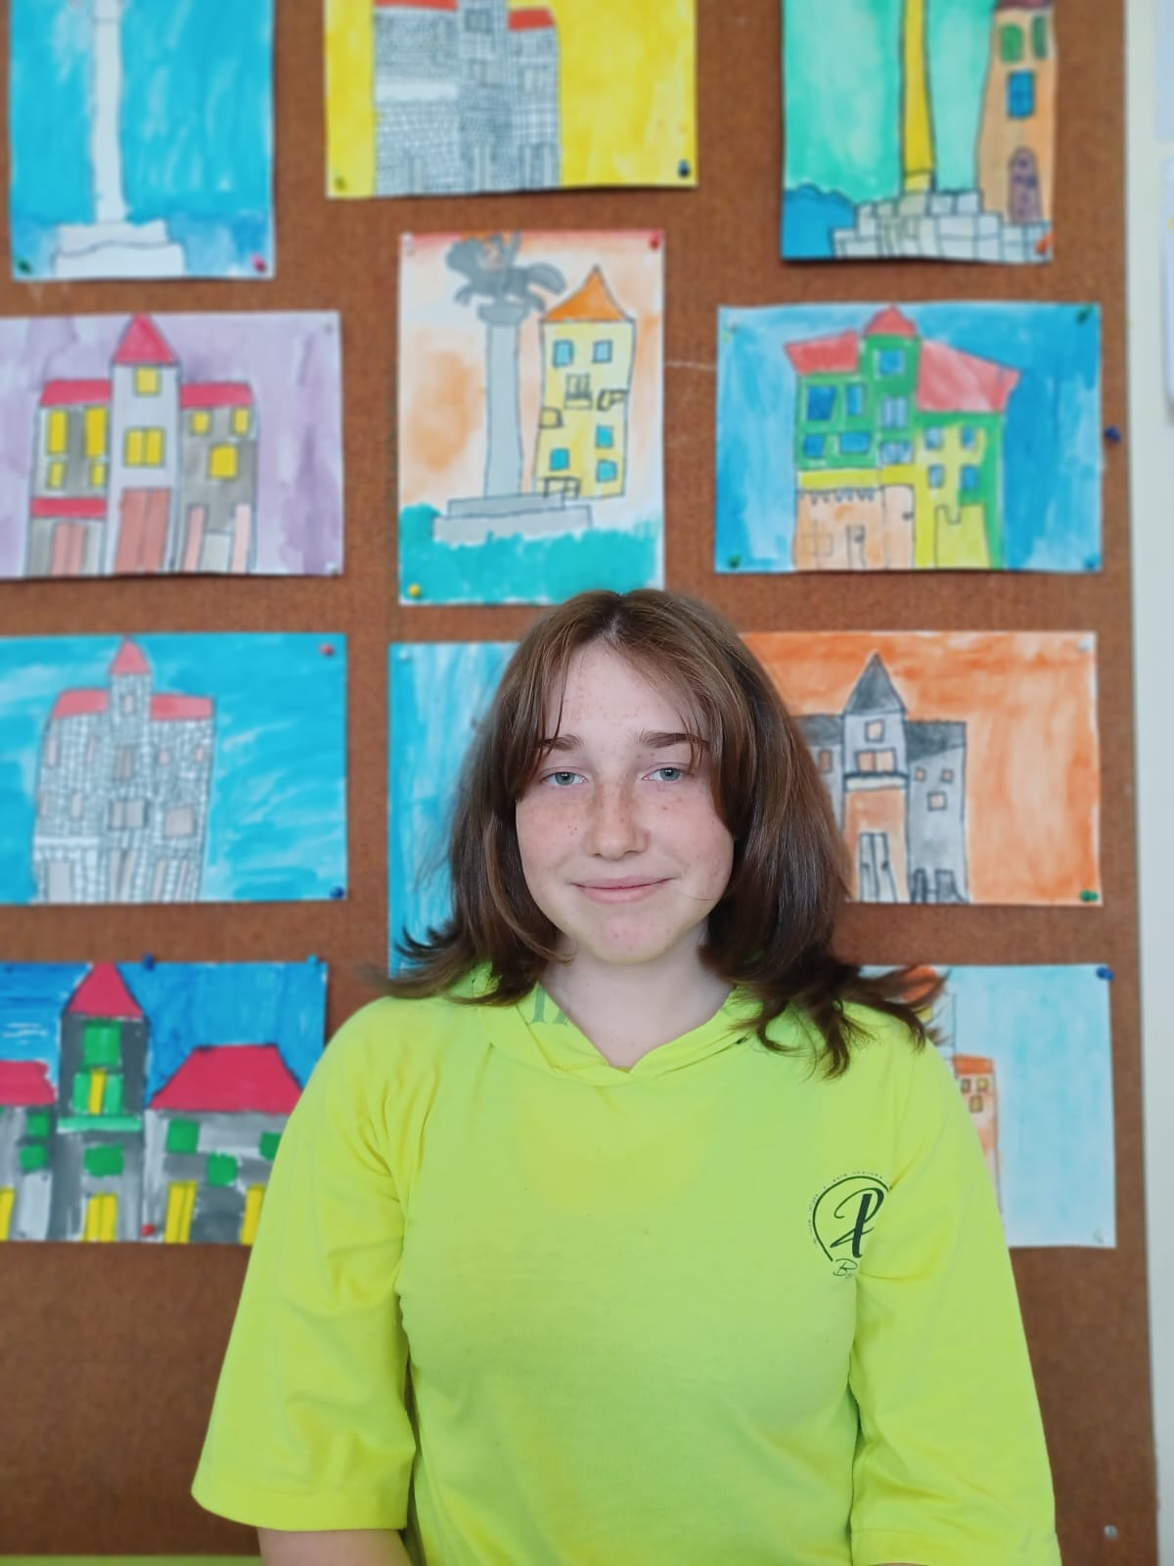
Mia Kozlica
Age:14
Likes: drawing, painting, music and animals
Doesn’t like: tomatos

Slide 6
Nikola Šego
Age: 14
Likes: movies,sports,food,football
Doesn’t like: cats

Slide 7
Antonio Matej Gverić or AMG
Age: 14
Likes: Chess, drawing, science, math, sports
Doesn’t like: Mushrooms

Slide 8
Sara Šimić
Age:13 Years old
Likes:dogs,traveling,food,films/ series , plants and swimming
Doesn’t like:Cats,Bananas

Slide 9
Nika Puljas
Age:13
Likes:dogs,sea,
animals,Croatia,
biology,football,
roses
Doesn’t like:spiders,clowns

Slide 10
Ana Vidović
Age:13
Likes:adventure,
nature,learning,
swimming,sports,
animals
Doesn’t like:bugs,tomatoes

Slide 11
Marko Parčina
Age: 13
Likes: video games, volleyball
Doesn’t like: math

Slide 12
Petar
Age:13
Likes: Food, P.E., basketball
Doesn’t like: school and broccoli

Slide 13
Felicija Vrtlar
Age:13
Likes: dance, k-dramas, summer, music
Doesn’t like:bugs

Slide 14
How to introduce Croatia to you..?
It’s all about…
the sea
the islands
our culture and tradition
football

Slide 15
What do we associate with Greece?
Greek yoghurt, sea
Greek alphabet
Greek mythology

Slide 16
Kaštela
Lots of beaches
Houses made of stone
Friendly people

Slide 17
Meet the teachers…

Slide 18
Teacher Tijana
English and Italian
Likes: friendly people, nice weather, pink colour and pita me jiro!
Doesn’t like: snakes

Slide 19
Teacher Tihana
Geography and English teacher
Likes: nature, travelling, teaching, meeting people
Doesn’t like: mushrooms

Slide 20
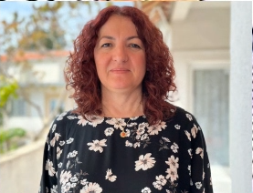
Headmistress Nives
Religious Education teacher
Likes: long walks, bike riding
Doesn’t like: snakes

Slide 21
Meet the school…

Slide 22
How does our school affect the enviroment
We get involved in many eco projects
We have classes where we learn about enviromental problems
We have interclass competitions about recycling

Slide 23
We can´t wait to meet you all!!

